Slide 1
Freshman 101
What you need to know this year!

Slide 2
Freshman Pre-Test Instructions
1.Go to connection.naviance.com/glencoehs
2.Login to your Naviance account
Username:
First 4 letters of last name + first initial + last 3 numbers of student ID#
Password:
Student ID#
3. Under the About Me tab at the top, select the 9th Grade Pre-Test link from the upper left hand side of the screen
4. Take the survey and work on your own!
5. Answer each question-be aware that some responses are from a drop down menu and some will have more than one response.
6. Once completed, click the Submit button and submit.

Slide 3
Why you’re here today
Understand how grades and credits work
Learn what a transcript is
Become aware of what help there is for you if you need it
Understand how your counselor can help you

Slide 4
YOUR COUNSELING TEAM!
COUNSELORS ARE HERE TO HELP EVERY STEP OF THE WAY!
GLENCOE COUNSELORS:
Mrs. Buyas-Grades 10/12 A-L
Ms. Velasco-Grades 9/11 A-L
Mr. Steele-Grades 9/11 M-Z
Mr. Dortch-Grades 10/12 M-Z
WE ALSO HAVE OTHER COUNSELORS:
Mrs. Seitz: Youth Contact Counselor who helps with personal and family troubles
Mrs. Fields College and Career counselor
Make Appointments in the Counseling Center for any of us!

Slide 5
What do counselors do?
Brainstorm with a partner, then we’ll share out as a group!
Personal/family/peer issues
Run groups
Crisis counseling
Scheduling
Classroom guidance
Academic planning
Planning for after high school

Slide 6
How Grades work in high school
You will get a full grade report every 4 ½ weeks!
This helps you keep track of how you’re doing in EACH class on a regular basis
0 MD1 QT1 MD2 SM1
(all grades) (all grades) (all grades) (all grades)
October November December January
Semester grades go on transcript!

Slide 7
How grades turn into credit
Transcript: the permanent record/document of the courses you’ve taken, the grades you’ve earned and your progress towards graduation
The grades you receive at the end of each semester are the ones that go on your transcript and give you credit
Not mid-term or quarter grades – these are like progress reports; only semester grades go on the actual transcript
One semester class = .5 credit
If you are taking 8 classes, and you pass them all, you earn 4 credits for that semester
If you take a year-long class, it is broken into two separate semesters
Each earns .5 credit if you pass
Each earns it own separate letter grade
For a STANDARD DIPLOMA, you need at least 24 credits by the end of senior year!

Slide 8
Grades and GPA
GPA = Grade Point Average
Starts your first semester of high school (now!) and goes until the second semester of senior year
Cumulative GPA: every grade you’ve earned in high school
Based on a value that each grade earns:
A = 4, B = 3, C = 2, D = 1, F = 0
Class Rank: Puts all freshman in order based on your GPA, with highest GPAs listed at the top
Example: 4.0 GPA is ranked as #1 in the class (there can be several at each ranking)

Slide 9
THINK, PAIR, SHARE
LOOK OVER THESE GPA EXAMPLES, AND TELL US WHAT YOU THINK:
Straight As = ___ GPA?
2.5 GPA = what kind of grades?
What value does an F have on your GPA?

Slide 10
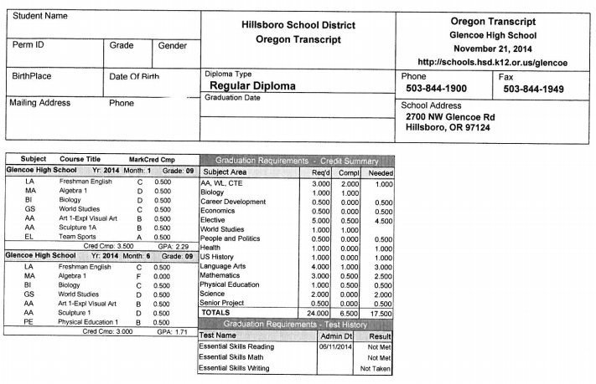
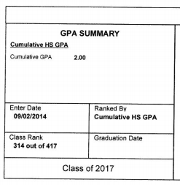
Example transcript

Slide 11
ATTENDANCE
Your attendance greatly affects your grades and performance in school
Consequences for missing school/skipping:
In School Suspension/Suspension
Meeting with Officer Rios
Fines/Truancy Court - $200
What to do if you miss school:
Talk to your teacher beforehand, if possible! (or email them while you’re gone!)
Talk to your teachers as soon as you get back to school
Many teachers (including all of your World Studies teachers ☺) have websites you can check for notes, assignments, etc.
Do makeup tests promptly (use the testing center!)

Slide 12
How your grades can affect your future
College:
4-Year Universities have a requirement for admissions, usually 3.0 or higher
2-Year colleges do not have a requirement, but some of the programs do
Scholarships: FREE MONEY! ☺
Many scholarships are based on your academic performance
The higher your GPA, the more scholarships you may be eligible for
Colleges have their own scholarships they can give you, many based on GPA

Slide 13
How your grades can affect your future
Athletic/Activity Eligibility:
Pass at least 5 classes
Have at least a 2.0 GPA if any Fs
Will be unable to compete (but can still practice) until a grade report shows eligible
Research shows that involvement in sports/activities/clubs helps make you a better student
Time management, commitment, teamwork, responsibility

Slide 14
How your grades can affect your future
Jobs/References:
You are more hirable when you perform better
People you use as references or letters of recommendations will have better things to say!
Car Insurance
Often a Good Drive Discount which equals less to pay!

Slide 15
THINK, PAIR, SHARE
Review and explain the 5 ways grades can affect your future

Slide 16
What can you do?
Student VUE:
Use the login username and password of your school account
Can give you information about grades, missing assignments, test grades, etc.

Slide 17
What can you do?
Advocate for Yourself:
Connect with your teachers – big resource of information for your success!
Ask questions during class
Seek help outside of class
Hearing information one time may not be enough to fully understand
All steps needed before seeing counselor about a schedule change!
Meet with your Counselor:
Problem-solve areas where you can improve
Check-ins about progress
Study Hall:
Need to add for second semester?

Slide 18
Your study skills
Study Place
No distractions, quiet
Same time each day to get into a good routine
Have all the materials you need in one place
If you don’t have one at home (siblings, no space), stay for Learning Lab!
Take notes in class
And keep handouts and worksheets
Use these to prepare for upcoming tests/quizzes
Study for tests/quizzes!
Don’t do one cram session; study in smaller chunks the 3-5 days prior to the test
Review all notes (re-write them!) and handouts until you feel prepared
Ask questions before the test

Slide 19
Your study skills
Stay organized:
Use tabs, separate folders, have A day and B day binders – whatever works for you!
Staying organizes makes sure you know where unfinished work can be found, and where the things you just need to hand in are
Use a planner/calendar:
Don’t rely on your memory!
Helps you plan out your study time and be more efficient
Especially if you have commitments outside of school

Slide 20
In short…
Doing well in school will build your confidence, give you more skills and increase your opportunities
after high school,
no matter what kind of student you are.
We are all here to help you!

Slide 21
TIME FOR JEOPARDY!

